Slide 1



Multimodal evaluation of affective data in videoconference sessions
Author: Mário Francisco Costa Silva
Supervisors: Susana Brás and Ilídio Oliveira

Slide 2

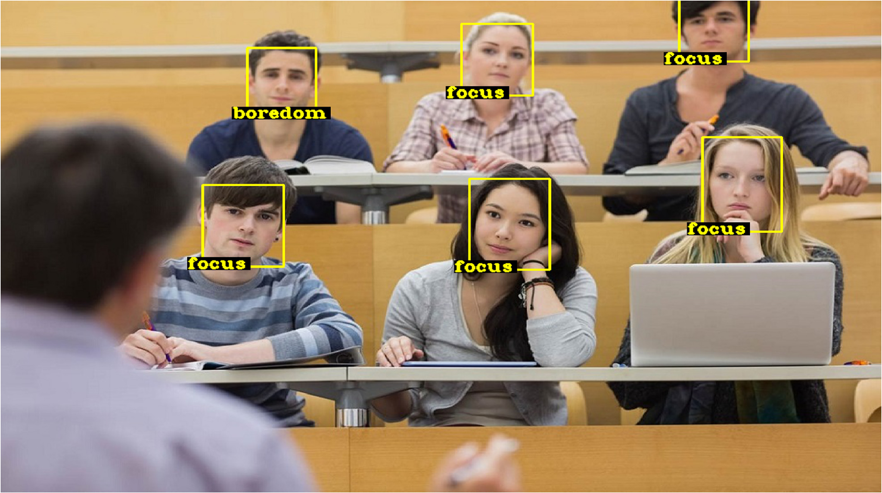
Introduction
“Just like we can understand speech and machines can communicate in speech, we also understand and communicate with humor and other kinds of emotions. And machines that can speak the language of emotions are going to have better, more effective interactions with us.” - MIT Sloan professor Erik Brynjolfsson
Notes:
a minha dissertação baseia-se na área da computação afetiva, que tem vindo a crescer ao longo dos anos, e tem como objetivo perceber e medir o estado emocional de humanos.
Reconhecimento de emoções e analise sentimental sao dois conceitos que são consideradas duas sub tarefas da computação afetiva. Analise sentimental permite entender de maneira geral o estado emocional, normalmente através de polaridade de sentimento, isto é, ao classificar um humano como estando com um sentimento positivo, neutro, ou negativo. Já reconhecimento de emoções usa um amplo espectro de emoções humanas como por exemplo medo, alegria, ou tristeza.
Esta deteção de emoções é bastante útil em contextos de video conferencias, por exemplo, em aulas de ensino online, pode ajudar a um professor a adaptar a sua aula, em call centers, ajuda a detectar possiveis problemas de uma chamada, e avaliar a satisfação de um cliente e a sua evolução de estado emocional.

Slide 3
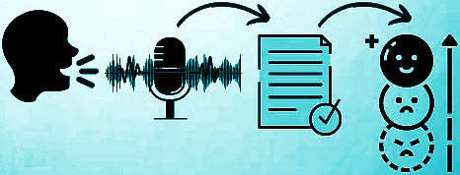
Objectives
Develop a Speech Emotion Recognition (SER) model and apply it to a video conference system.
Offline and in real-time analysis.
Explore multimodal approaches to emotion recognition and ways to deal with multiple input channels.
Notes:
Portanto, temos como objetivos desenvolver um sistema de reconhecimento de emoções através da fala, num contexto de uma video conferencia.
Pretendemos também que seja possível realizar a deteção de emocções tanto em tempo real como depois da conferência terminar.
E apesar de focarmos na fala, iremos também explorar de que forma outras modalidades como expressões faciais podem melhorar o sistema.

Slide 4
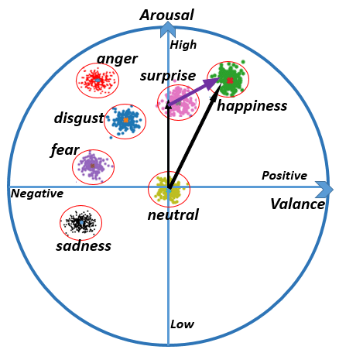
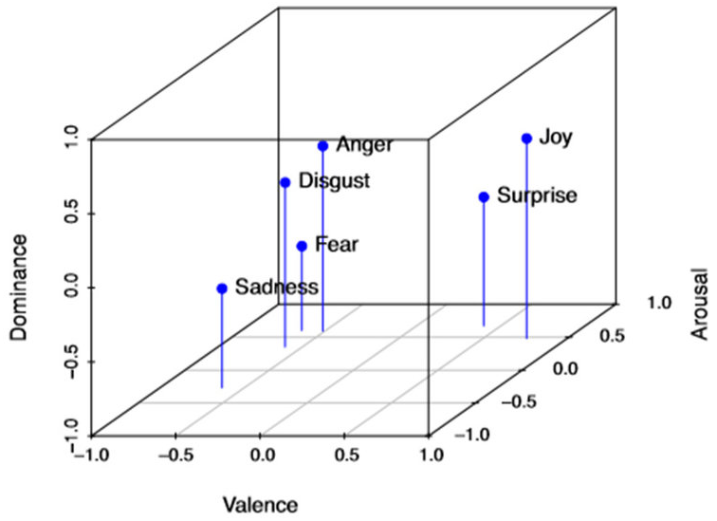
Emotion
The concept of emotion should be carefully defined when building emotion recognition systems.
There is still no consensus of an accurate representation due to its natural subjectivity, however, the main accepted and utilized for are the discrete and dimensional models.
Discrete emotions in a 2-D valence-arousal plane.
Discrete emotions in a 3-D valence-arousal-dominance plane.

Slide 5
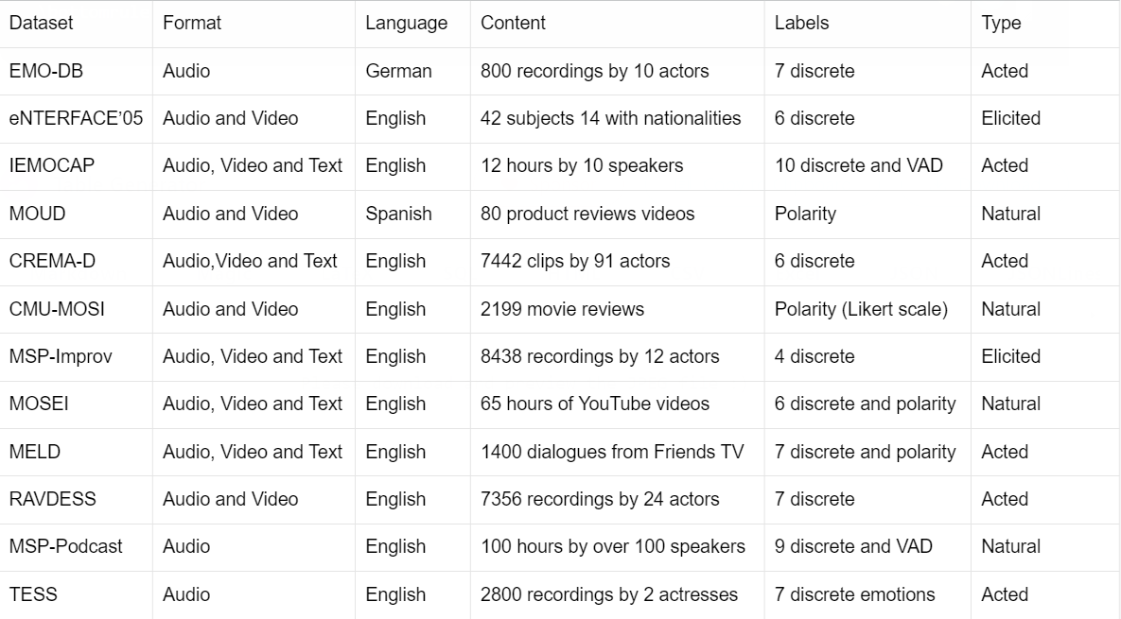
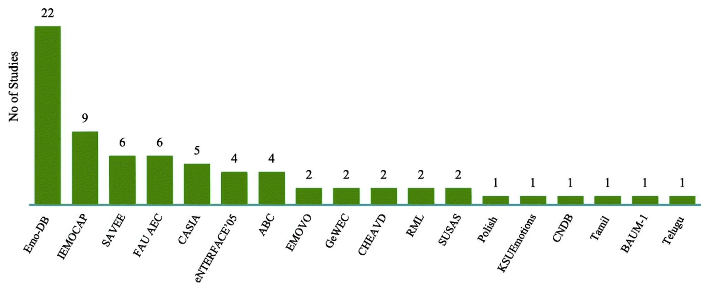
Emotion
Recognition
Datasets
Summary and description of emotion recognition datasets.
Frequency distribution of used databases in reviewed articles from a SOTA emotion recognition survey

Slide 6
SER - Speech Features (1)
Speech is a vital tool for human communication and social interaction. It is a continuous signal that can convey information, emotions and meaning.
Prosodic Features
Can be perceived by humans, such as intonation, rhythm, and loudness.
Energy
Pitch
Duration
Spectral Features
Obtained by transforming the time domain signal into the frequency domain.
Mel-frequency cepstral coefficients (MFCC)
Mel spectrogram
Spectral centroid
Spectral bandwidth
Spectral contrast
Roll-off frequency
Voice Quality Features
Distinctive characteristics of a person's voice and measure of the overall voice quality.
Jitter
Shimmer
Harmonics-to-noise ratio

Slide 7
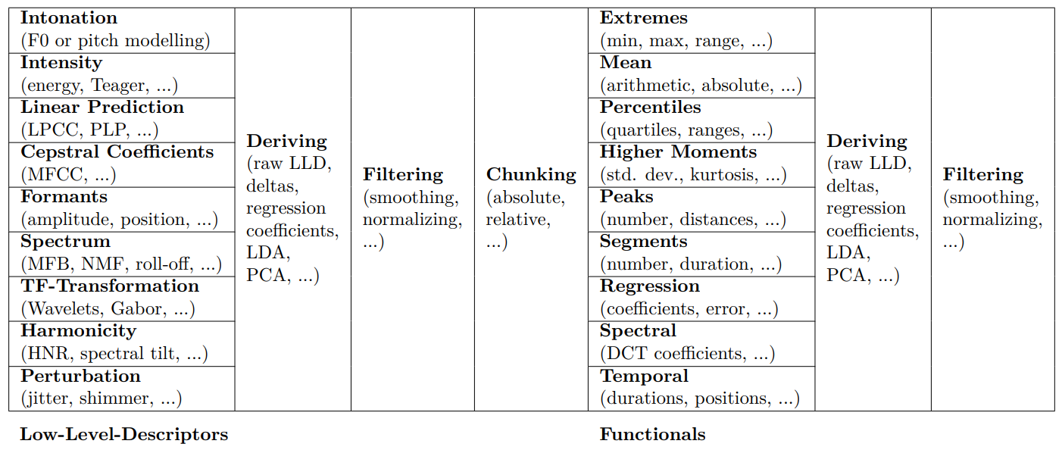
SER - Speech Features (2)
Overview on features commonly used for acoustic and linguistic emotion recognition.

Slide 8
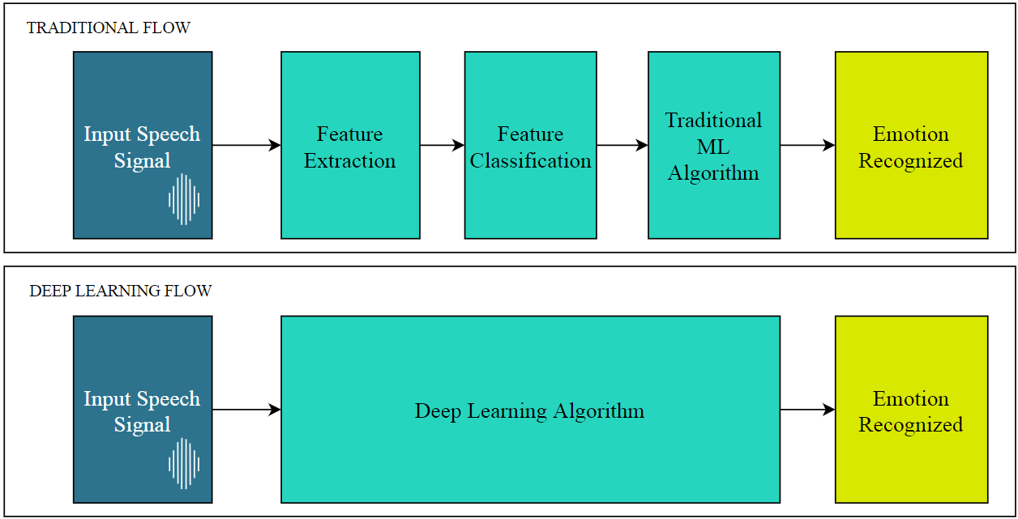
SER - Strategies (1)
Traditional feature-based flow vs. automatic feature extraction with deep learning flow

Slide 9
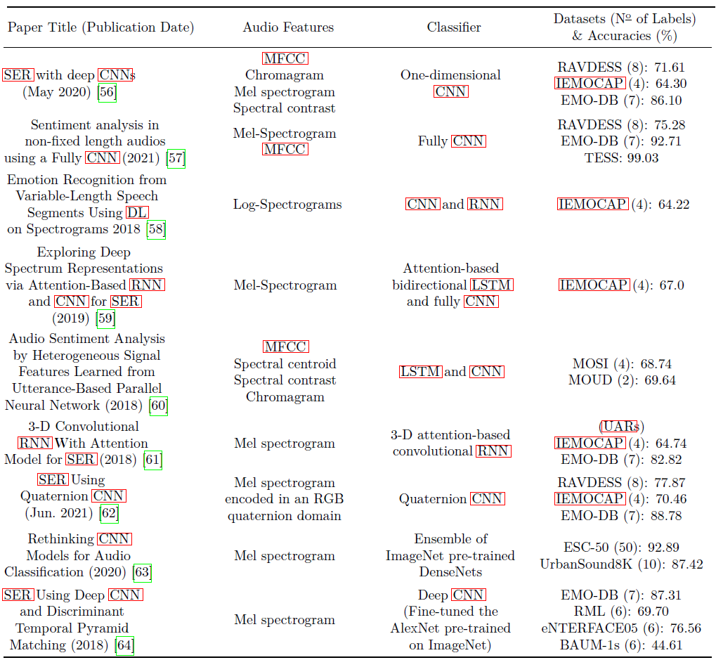
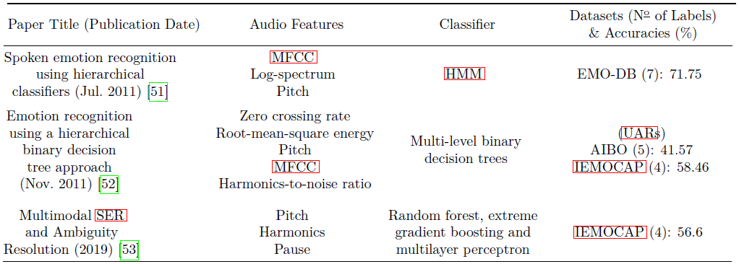
SER - Strategies (2)
Audio classification articles with deep learning-based approaches
Audio classification articles with traditional feature-based approaches

Slide 10



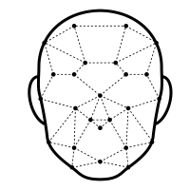

Multimodal Emotion Recognition
Multiple channels can be used as input which then require a fusion technique. Fusion can be at the feature, decision, or at model level. Hybrid approaches make fusions at multiple levels.
Speech
Facial
Text
Data Gathering
Fusion
Emotion Analysis

Slide 11
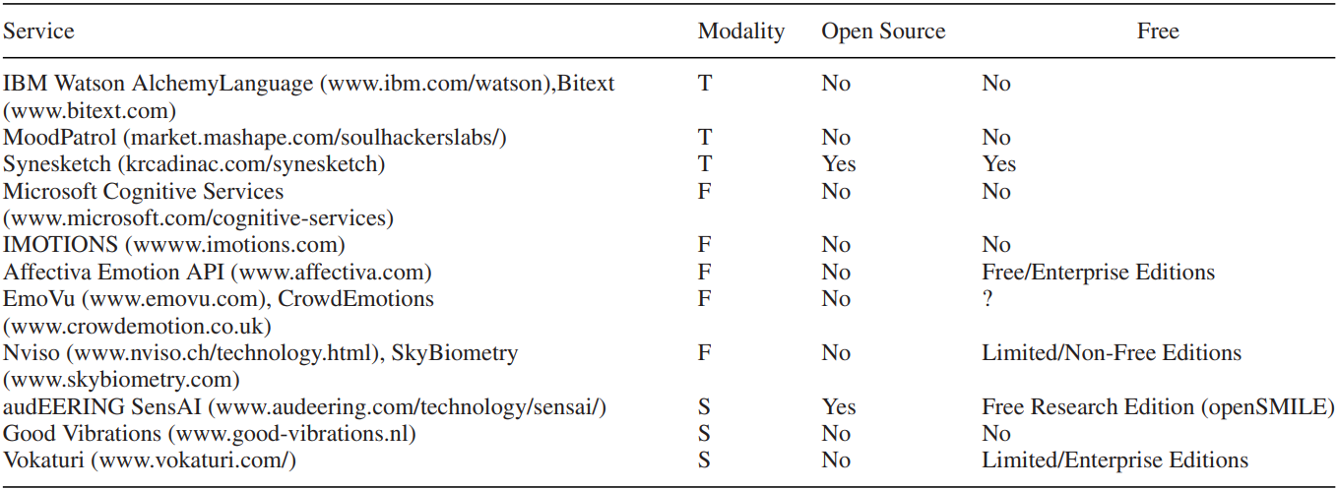
Emotion Recognition Services
Emotion recognition services for facial, textural, and speech contents from a 2018 survey paper.

Slide 12
State-Of-The-Art Key Takeaways
Selecting a a large and diverse emotional corpus must be performed carefully to fit the system needs.
Audio feature engineering is a critical for SER due to the large variety of features and the need to reduce them.
Traditional feature-based approaches use more classical models and focus mainly on the feature selection methods.
DL strategies are on the rise, and have, in general, outperformed the traditional feature-based approach.
Current solutions in the market are taking advantage of multimodality. Initially, a lot of services focused on facial expressions to recognize emotions, but have now seen more success in using multiple channels of information.
There remains a lot of limitations to overcome and areas to improve, e.g., systems don’t adapt the weights given to each input channel accordingly (noisy audio or low brightness), research for real-time analysis is still underdeveloped.

Slide 13
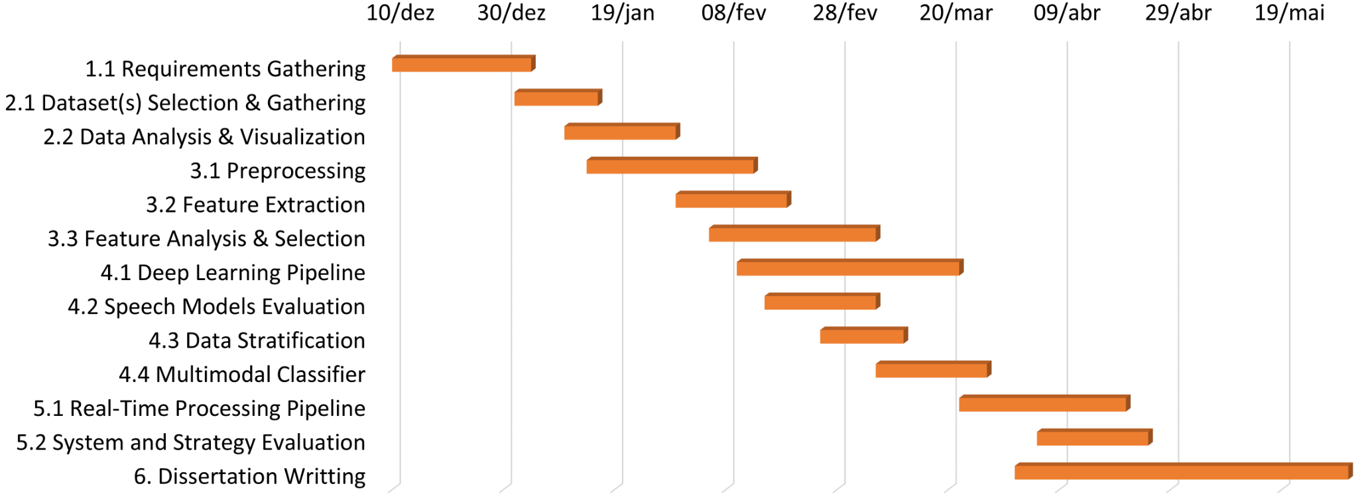
Methodology - Work Schedule
1. System Requirements 2. Dataset 3. Audio Feature Engineering
4. Models Implementation 5. Deployment 6. Documentation

Slide 14
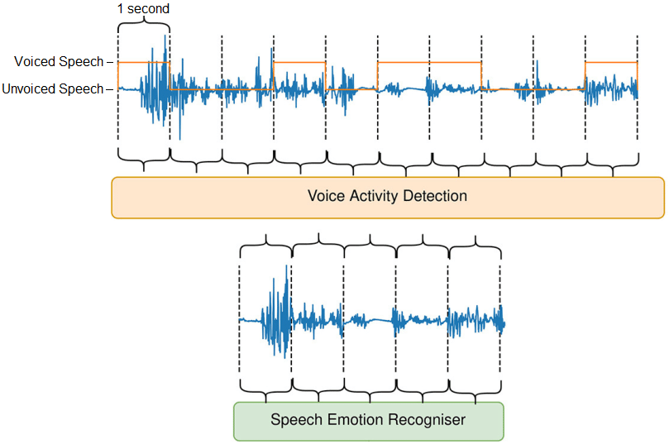
Methodology - Preprocessing
Preprocessing Techniques
Voice Activity Detection
Framing
Windowing
Noise Reduction
Normalization

Slide 15
Methodology - Ethical Concerns and Procedures
CONCERN | PROCEDURES
System may not be accurate in recognizing emotions for people with certain characteristics (age, gender, accents, speech disabilities, races, etc.). | We will address and quantify potential biases present in our models.
System may be used to monitor or control participants without their consent. | Our models will only be in use when participants fully consent to submit their data for emotional evaluation purposes.
Personal data collected being vulnerable to hacks or used for unintended purposes. | Our pipelines will only utilize the participant’s streaming data for the SER models input, and, will not store or use the sensitive data for any other purposes than emotional analysis.
Revealing or identifying confidential data such as personal, financial, or business information. | We decided to not include speech transcriptions, and therefore, we will not be capturing the actual words spoken.

